Slide 1
Monolithic Architecture

Slide 2

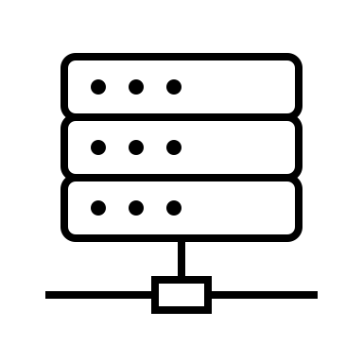

What is a Monolithic Architecture?
Traditional and unified approach to software development.
Application is built as a single, tightly integrated unit.
It usually involves
Client-side
Server-side
Database layer
Clients
Auth
Product
Cart
Order
Database
Uzochukwu Eddie Odozi
https://kickchat.download

Slide 3
Benefits of a Monolithic Architecture
Single codebase
Simple to develop
Easy deployment
Easier debugging
Simplified testing
Single technology stack
Uzochukwu Eddie Odozi
https://kickchat.download

Slide 4
Challenges of a Monolithic Architecture
Potentially difficult to understand and maintain due to its size and complexity
Less team autonomy
Single technology stack
Potentially slow deployment pipeline
No possibility of scaling individual subdomains
If there’s an error in any subdomain, it could affect the entire application.
Uzochukwu Eddie Odozi
https://kickchat.download

Slide 6
Microservices Architecture

Slide 7


What is Microservices Architecture?
Architectural style that structures an application as a collection of small, independently deployable services
Architectural is oriented mainly to the back-end, although the approach is being used for the front-end
Services communicate via well-defined APIs
Communication uses protocols such as HTTP/HTTPS, Websockets, or Advanced Message Queuing Protocol (AMQP)
API communication could be direct client-to-microservice or API gateway pattern
Clients
API Gateway
Microservice
Microservice
Microservice
Microservice
Database
Database
Database
Database
Uzochukwu Eddie Odozi
https://kickchat.download

Slide 8
Benefits of Microservices Architecture?
Scalability: Microservices allow each service to be independently scaled to meet demand for the application feature it supports.
Faster Development: Teams can work on and release individual services independently, leading to faster development cycles.
Flexibility in technology Stack: This allows teams to choose the best tools and programming languages for specific tasks.
Fault Isolation: Microservices are designed to be fault-tolerant. If one service fails, it doesn’t necessarily bring down the entire system.
Uzochukwu Eddie Odozi
https://kickchat.download

Slide 9
Improved Maintainability: Smaller services are easier to understand, maintain and update.
Isolation of Data: Microservices can have their own data storage solutions, which can lead to improved data isolation and security.
Enhanced Monitoring and Observability: Each service can have its own monitoring and observability tools, making it easier to track performance, troubleshoot issues, and gather insights into the behavior of a system.
Easy Deployment: Microservices enables continuous integration and continuous delivery, making it easier to try out new ideas.
Uzochukwu Eddie Odozi
https://kickchat.download

Slide 10
Challenges of Microservices Architecture?
Operational Complexity: Managing a large number of microservices can be operationally complex in terms of infrastructure, tools for deployment, monitoring, etc.
Inter-Service Communication: As microservices rely on network communication, there can be issues with latency, reliability, and data consistency between services.
Testing and Debugging: testing microservices individually and ensuring proper integration can be challenging. Debugging issues that span multiple services can be complex and time-consuming.
Uzochukwu Eddie Odozi
https://kickchat.download

Slide 11
Security and Compliance: Security can be more challenging in a microservices environment, as there are more potential entry points for security breaches.
Monitoring and Observability: Monitoring and tracking the behavior of multiple microservices can be complex.
Team Communication and Collaboration: Effective communication and collaboration between teams are crucial for asuccessful implementation.
Uzochukwu Eddie Odozi
https://kickchat.download

Slide 13
Microservices Communication Types

Slide 14


Synchronous Communication
The client sends a request and waits for a response from the service.
HTTP uses synchronous communication.
The communication protocol can be HTTP or HTTPS.
Client
Server
Request
Response
Uzochukwu Eddie Odozi
https://kickchat.download

Slide 15
Asynchronous Communication
The client sends a request but doesn’t wait for a response from the service(s).
It uses AMQP (Advanced Message Queuing Protocol)with message brokers like Kafka and RabbitMQ.
Communication could be one-to-one or one-to-many.
Microservice
Microservice
Message Queue
Microservice
Microservice
Uzochukwu Eddie Odozi
https://kickchat.download

Slide 17
Microservices Communication Styles

Slide 18
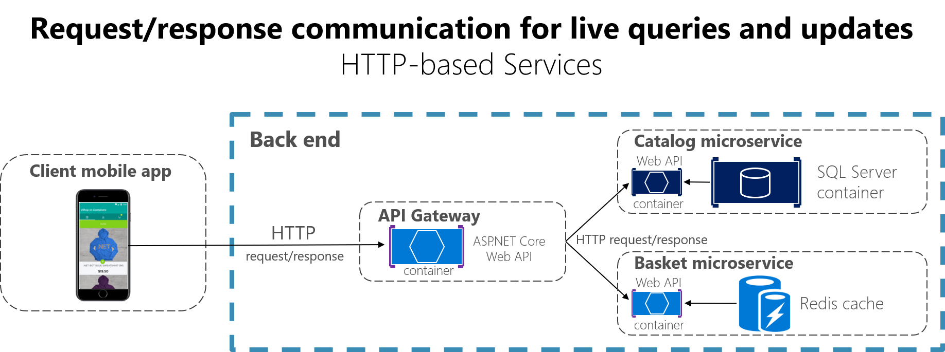
Source: Microsoft Learn
Uzochukwu Eddie Odozi
https://kickchat.download

Slide 19
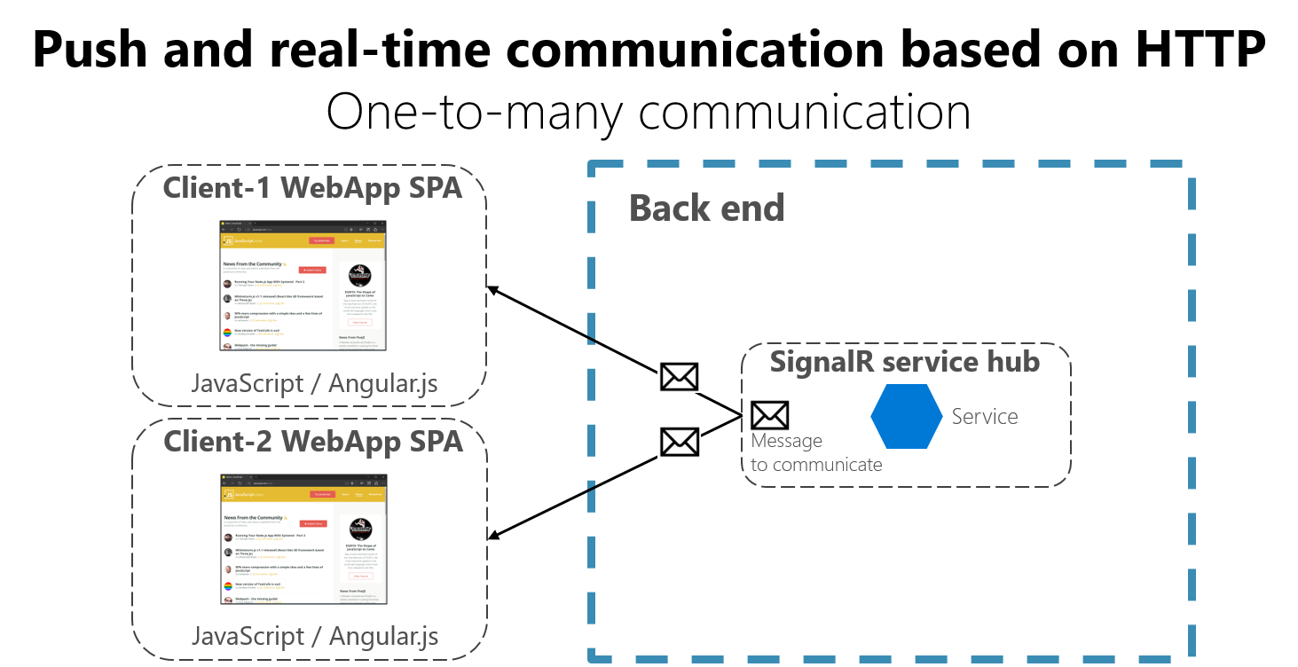
Source: Microsoft Learn
Uzochukwu Eddie Odozi
https://kickchat.download

Slide 20
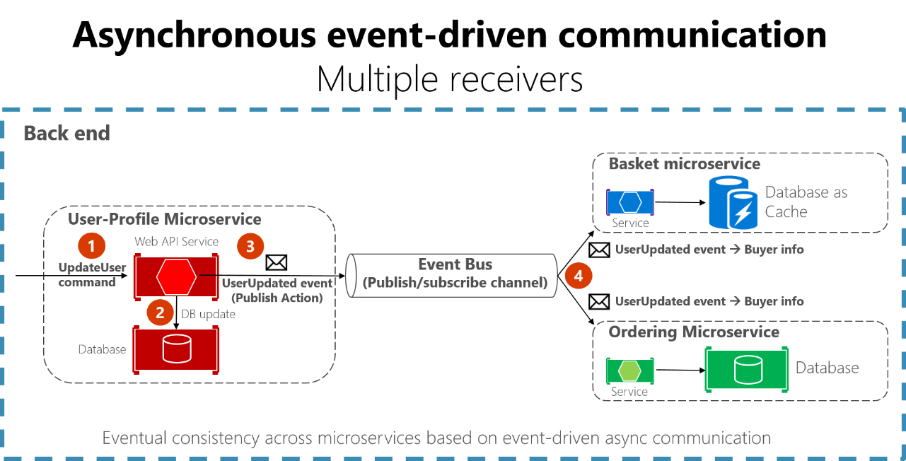
Source: Microsoft Learn
Uzochukwu Eddie Odozi
https://kickchat.download

Slide 22
Project Description

Slide 23
What are we going to build?
A freelance marketplace where sellers can create gigs and buyers can purchase gigs or custom gigs.

Slide 24














Freelance Marketplace Subdomains
Handles sending emails to users
Handles gig CRUD operations
Handles reviews and ratings
NOTIFICATION
SERVICE
GIG
SERVICE
REVIEW
SERVICE
Handles users authentication
Handles buyers and sellers messaging
AUTH
SERVICE
CHAT
SERVICE
Handles Sellers and Buyers Profiles
Handles orders and payment
USERS
SERVICE
ORDER
SERVICE
Uzochukwu Eddie Odozi
https://kickchat.download

Slide 26
Functional Requirements

Slide 27
Functional Requirements
Functional requirements are specific features, behaviors, and capabilities that a system must possess.
These requirements describe what the system should do.
They are typically defined in detail to guide the design, development, and testing processes.
Functional
Requirements
Uzochukwu Eddie Odozi
https://kickchat.download

Slide 28
Freelance Marketplace Domain Requirements
User Authentication
Create accounts, login, password reset
User Profiles
Create a seller’s profile
Update profile
Search and Filters
Search for gigs
Messaging System
Buyers should be able to message sellers
Rating and Reviews
Buyers can review sellers
Sellers can review buyers
Payment Gateway Integration
View Orders
Buyers and sellers can view active, completed and cancelled orders
Cancellation of Orders
Functional
Requirements
Uzochukwu Eddie Odozi
https://kickchat.download

Slide 29
Non-functional Requirements

Slide 30
Non-functional Requirements
Non-functional requirements describes how the system should perform, rather than what it should do.
NFR are requirements that describes how the system works.
They focus on the quality attributes and constraints that a system must meet.
NFR are as equally important as functional requirements because they impact the user experience with the system.
Non-functional
Requirements
Uzochukwu Eddie Odozi
https://kickchat.download

Slide 31
Freelance Marketplace Domain Requirements
Scalability
The system should be able to scale to accommodate increased load during peak times.
Availability
The system should be available 99.99% of the time
A failover mechanism should ensure high availability in case of server failures
Reliability
The system should be dependable
Maintainability
Code should follow coding standards and be well-documented
Regular code reviews and automated testing should be performed
Usability
Users should find the system easy to use
Security, Performance, Capacity
Non-functional
Requirements
Uzochukwu Eddie Odozi
https://kickchat.download
Notes:
Users should fiasy

Slide 33
Design Decisions

Slide 34
No direct client-to-microservice communication.
All request from client must go through API gateway.
Communication between API gateway and other microservices will be HTTP based and socket.io.
Inter-process communication between microservices will only be event-driven. No HTTP request/response.
Token generation and management will be handled by API gateway.
All microservices except API gateway will not be accessible from outside.
Every request from API gateway will include a token.
Microservices will send client errors to API gateway but other errors will be sent to monitoring and logging system.
Design
Decisions
Uzochukwu Eddie Odozi
https://kickchat.download
Notes:
Users should fiasy

Slide 36
Project Architecture

Slide 37



Project Architecture
CLIENT
HTTP/HTTPS
HTTP/HTTPS
SOCKET.IO
HTTP/HTTPS
API
GATEWAY
HTTP/HTTPS
SOCKET.IO
HTTP/HTTPS
HTTP/HTTPS
HTTP/HTTPS
HTTP/HTTPS
HTTP/HTTPS
SOCKET.IO
HTTP/HTTPS
SOCKET.IO
HTTP/HTTPS
NOTIFICATION
SERVICE
AUTH
SERVICE
USERS
SERVICE
GIG
SERVICE
CHAT
SERVICE
ORDER
SERVICE
REVIEW
SERVICE
MYSQL
RABBITMQ
MONGODB
MONGODB
MONGODB
POSTGRESQL
RABBITMQ
RABBITMQ
MONGODB
REDIS
RABBITMQ
RABBITMQ
RABBITMQ
RABBITMQ
HTTP/
HTTPS
HTTP/HTTPS
HTTP/HTTPS
HTTP/HTTPS
HTTP/HTTPS
HTTP/HTTPS
HTTP/HTTPS
ELASTICSEARCH/KIBANA
Uzochukwu Eddie Odozi
https://kickchat.download

Slide 39
Inter-process Communication

Slide 40


Inter-Process Communication
NOTIFICATION
SERVICE
AUTH
SERVICE
USERS
SERVICE
GIG
SERVICE
CHAT
SERVICE
ORDER
SERVICE
REVIEW
SERVICE
Send | Receive
- | Auth
- | Order
- | Chat
- | -
Send | Receive
Notifi… | -
Users | -
- | -
- | -
Send | Receive
Gig | Auth
- | Order
- | Gig
- | Review
Send | Receive
Users | Users
- | -
- | -
- | -
Send | Receive
Notifi… | -
- | -
- | -
- | -
Send | Receive
Users | Review
Notifi… | -
- | -
- | -
Send | Receive
Users | -
Order | -
- | -
- | -
Send $≈$Producer
Receiver $≈$Consumer
Uzochukwu Eddie Odozi
https://kickchat.download

Slide 42
Local Development Tools

Slide 43
Development tools
VSCode
Docker and Docker-Compose
Rabbitmq
Elasticsearch and Kibana
Mongodb
MySQL
Postgresql
Redis
Uzochukwu Eddie Odozi
https://kickchat.download

Slide 44
Helper/Shared Library

Slide 45
To avoid duplicate codes across microservices
Why do we need a helper library?

Slide 46
Challenges
If you need to update the library, you have to go through the process of updating, pushing and running pipeline.
Updating all services that requires the new version
Best case scenerio is updating only one service
Worst case scenerio is updating all services
Uzochukwu Eddie Odozi
https://kickchat.download

Slide 47
Helpers
Interfaces
Cloudinary upload methods
Error handlers
API gateway middleware
Logger methods
Helper methods
Uzochukwu Eddie Odozi
https://kickchat.download

Slide 48
Notification Service

Slide 49





Notification Emails
NOTIFICATION
SERVICE
Verify Email
Forgot Password
Reset Password
Offer
Order
Placed
Receipt
Extension Request
Extension Approval
Delivered
Uzochukwu Eddie Odozi
https://kickchat.download

Slide 50
Inter-Process Communication
NOTIFICATION
SERVICE
AUTH
SERVICE
USERS
SERVICE
GIG
SERVICE
CHAT
SERVICE
ORDER
SERVICE
REVIEW
SERVICE
Send | Receive
- | Auth
- | Order
- | Chat
- | -
Send | Receive
Notifi… | -
Users | -
- | -
- | -
Send | Receive
Gig | Auth
- | Order
- | Gig
- | Review
Send | Receive
Users | Users
- | -
- | -
- | -
Send | Receive
Notifi… | -
- | -
- | -
- | -
Send | Receive
Users | Review
Notifi… | -
- | -
- | -
Send | Receive
Users | -
Order | -
- | -
- | -
Send $≈$Producer
Receiver $≈$Consumer
Uzochukwu Eddie Odozi
https://kickchat.download

Slide 51
RabbitMQ Channel Methods
channel.publish
Publish a message to an exchange
channel.assertExchange
Asserts an exchange into existence
channel.assertQueue
Checks if a queue exists
If it does not exist, it creates a new queue
channel.bindQueue
Assert a routing path from an exchange to a queue
channel.consume
Set up a consumer with a callback to be invoked with each message
channel.ack
Acknowledge the given message
Uzochukwu Eddie Odozi
https://kickchat.download

Slide 52
API Gateway Service

Slide 53
API Gateway
CLIENT
HTTP/HTTPS
HTTP/HTTPS
SOCKET.IO
HTTP/HTTPS
API
GATEWAY
HTTP/HTTPS
SOCKET.IO
MICROSERVICES
ELASTICSEARCH/KIBANA
Uzochukwu Eddie Odozi
https://kickchat.download

Slide 54
Authentication Service

Slide 55
Auth Service Features
AUTH
SERVICE
Authentication
Search
Signup
Signin
Password Reset
Verify /
Resend Email
Token Refresh
Current User
Uzochukwu Eddie Odozi
https://kickchat.download

Slide 56
Auth Service Endpoints

Slide 57
Auth Service API Endpoints
Frontend to API Gateway – http(s)://<host>:<port>/api/v1/gateway/auth
API Gateway to Auth Service – http(s)://<api-gateway-host>:<port>/api/v1/auth
Name | API Endpoint | Verb
Signup | /signup | POST
Signin | /signin | POST
Verify Email | /verify-email | PUT
Forgot Password | /forgot-password | PUT
Reset Password | /reset-password/:token | PUT
Change Password | /change-password | PUT
Current User | /currentuser | GET
Resend Email | /resend-email | POST
Seeding Data | /seed/:count | PUT
Search Gigs | /search/gig/:from/:size/:type | GET
Search Gig | /search/gig/:gigId | GET
Uzochukwu Eddie Odozi
https://kickchat.download

Slide 58
Users Service

Slide 59


Users Service Features
USERS
SERVICE
Buyer
Seller
Uzochukwu Eddie Odozi
https://kickchat.download

Slide 60
Users Service API Endpoints (Buyer)
Frontend to API Gateway – http(s)://<api-gateway-host>:<port>/api/v1/gateway/buyer
API Gateway to Users Service – http(s)://<users-service-host>:<port>/api/v1/buyer
Name | API Endpoint | Verb
Buyer by Email | /email | GET
Buyer by Current Username | /username | GET
Buyer by Username | /:username | GET
Uzochukwu Eddie Odozi
https://kickchat.download

Slide 61
Users Service API Endpoints (Seller)
Frontend to API Gateway – http(s)://< api-gateway-host>:<port>/api/v1/gateway/seller
API Gateway to Users Service – http(s)://<users-service-host>:<port>/api/v1/seller
Name | API Endpoint | Verb
Seller by Id | /id/:sellerId | GET
Seller by Username | /username/:username | GET
Random Sellers | /random | GET
Create Seller | /create | POST
Update Seller | /:sellerId | PUT
Seeding Seller | /seed/:count | PUT
Uzochukwu Eddie Odozi
https://kickchat.download

Slide 62
Gig Service

Slide 63


Gig Service Features
GIG
SERVICE
Gigs
Search
Create
Read
Update
Delete
Uzochukwu Eddie Odozi
https://kickchat.download

Slide 64
Gig Service API Endpoints
Frontend to API Gateway – http(s)://<api-gateway-host>:<port>/api/v1/gateway/gig
API Gateway to Gig Service – http(s)://<gig-service-host>:<port>/api/v1/gig
Name | API Endpoint | Verb
Gig by Id | /:gigId | GET
Seller Gigs | /seller/:sellerId | GET
Seller’s Inactive Gigs | /seller/pause/:sellerId | GET
Gigs By Category | /category/:username | GET
Top Rated Gigs | /top/:username | GET
Similar Gigs | /similar/:gigId | GET
Create | /create | POST
Update | /:gigId | PUT
Update Active Gig | /active/:gigId | PUT
Delete Gig | /:gigId/:sellerId | DELETE
Seed | /seed/:count | PUT
Search | /search/:from/:size/:type | GET
Uzochukwu Eddie Odozi
https://kickchat.download

Slide 65
Chat Service

Slide 66

Chat Service Features
CHAT
SERVICE
Buyer/Seller Communication
Uzochukwu Eddie Odozi
https://kickchat.download

Slide 67
Chat Service API Endpoints
Frontend to API Gateway – http(s)://<api-gateway-host>:<port>/api/v1/gateway/message
API Gateway to Chat Service – http(s)://<chat-service-host>:<port>/api/v1/message
Name | API Endpoint | Verb
Get Conversation | /conversation/:senderUsername/:receiverUsername | GET
Messages by Username | /conversation/:username | GET
Messages by Sender Name and Receiver Name | /:senderUsername/:receiverUsername | GET
Messages by Conversation ID | /:conversationId | GET
Create Message | / | POST
Update Custom Offer | /offer | PUT
Mark Message as Read | /mark-as-read | PUT
Mark Multiple Messages as Read | /mark-multiple-as-read | PUT
Uzochukwu Eddie Odozi
https://kickchat.download

Slide 68
Chat Service Socket.io Connection

Slide 69
Frontend to API Gateway Connection
Client
Server
Socket Connection
Frontend
API Gateway
Uzochukwu Eddie Odozi
https://kickchat.download

Slide 70

API Gateway to Chat Service Connection
Client
Server
Socket Connection
API Gateway
Chat Service
Uzochukwu Eddie Odozi
https://kickchat.download

Slide 71
Order Service

Slide 72


Order Service Features
ORDER
SERVICE
Order
Notification
Uzochukwu Eddie Odozi
https://kickchat.download

Slide 73
Order Service API Endpoints
Frontend to API Gateway – http(s)://<api-gateway-host>:<port>/api/v1/gateway/order
API Gateway to Order Service – http(s)://<order-service-host>:<port>/api/v1/order
Name | API Endpoint | Verb
Order by Id | /:orderId | GET
Seller Orders | /seller/:sellerId | GET
Buyer Orders | /buyer/:buyerId | GET
Create Order | / | POST
Create Payment Intent | /create-payment-intent | POST
Cancel Order | /cancel/:orderId | PUT
Extension Request | /extension/:orderId | PUT
Extension Approval | /gig/:type/:orderId | PUT
Deliver Order | /deliver-order/:orderId | PUT
Approve Order | /approve-order/:orderId | PUT
Get Notifications | /notification/:userTo | GET
Update Notification | /notification/mark-as-read | PUT
Uzochukwu Eddie Odozi
https://kickchat.download

Slide 74
Review Service

Slide 75

Review Service Features
REVIEW
SERVICE
Buyer
Seller
Uzochukwu Eddie Odozi
https://kickchat.download

Slide 76
Review Service API Endpoints
Frontend to API Gateway – http(s)://<api-gateway-host>:<port>/api/v1/gateway/review
API Gateway to Review Service – http(s)://<review-service-host>:<port>/api/v1/review
Name | API Endpoint | Verb
Reviews by Gig Id | /gig/:gigId | GET
Reviews By Seller Id | /seller/:sellerId | GET
Create Review | / | POST
Uzochukwu Eddie Odozi
https://kickchat.download

Slide 77
Kubernetes Fundamentals

Slide 78
What is Kubernetes?
Kubernetes is a portable, extensible, opensource platform for managing containerized workloads and services.

Slide 79
What can Kubernetes do
Service discovery and load balancing
Storage orchestration
Automated rollouts and rollbacks
Automatic bin packing
Self-healing
Secret and configuration management
Horizontal scaling
IPv4/IPv6 dual-stack
Uzochukwu Eddie Odozi
https://kickchat.download

Slide 80
What Kubernetes is not
Kubernestes does not deploy source code and does not build your application. It is not used for CI/CD workflows.
Kubernetes does not provide application-level services, such as middleware, databases, caches as built-in services.
Kubernetes does not dictate logging, monitoring, or alerting solutions.
Kubernetes does not provide nor mandate a configuration language/system. It provides a declarative API.
Kubernetes does not limit the types of applications supported.
Uzochukwu Eddie Odozi
https://kickchat.download

Slide 81
Kubernetes Components

Slide 82
Kubernetes Cluster
Kubernetes Cluster
Node
Node
Node
Worker Machines
Control Plane
Uzochukwu Eddie Odozi
https://kickchat.download

Slide 83
Control Plane Components
kube-apiserver
Exposes the Kubernetes API.
It is the front end for the kubernetes control plane.
etcd
Consistent and highly-available key-value store for all cluster data.
kube-scheduler
Watches for newly created pods with no assigned node, and selects a node for them to run on.
kube-controller-manager
Responsible for running multiple controllers.
Monitors the current state of the cluster and changes the current state to the desired state.
cloud-controller-manager
Component that embeds cloud-specific control logic.
It lets you link your cluster into your cloud provider’s API.
kube-
controller-
manager
cloud-
controller-
manager
etcd
kube-
scheduler
kube-apiserver
Control Plane
Uzochukwu Eddie Odozi
https://kickchat.download

Slide 84
Node Components
Node
kubelet
Kubelet is the agent that runs on every node in the cluster.
The agent is responsible for making sure that containers are running in a Pod and healthy.
kube-proxy
Kube-proxy is the network proxy that runs on each node in your cluster.
They maintain network rules on nodes.
These network rules allow network communication to your Pods inside or outside your cluster
kubelet
kube-
proxy
Uzochukwu Eddie Odozi
https://kickchat.download

Slide 85
Kubernetes Objects

Slide 86
Pod
Pods are the smallest unit of deployment in Kubernetes.
They are used to deploy, scale, and manage containerized applications in a cluster
Uzochukwu Eddie Odozi
https://kickchat.download

Slide 87
Deployment
Deployment objects are used to manage the lifecycle of one or more identical Pods.
A Deployment allows you to declaratively manage the desired state of your application.
Uzochukwu Eddie Odozi
https://kickchat.download

Slide 88
ReplicaSets
In Kubernetes, Deployments don’t manage Pods directly.
The ReplicaSet ensures that the desired number of replicas (copies) are running at all times by creating or deleting Pods as needed.
Uzochukwu Eddie Odozi
https://kickchat.download

Slide 89
StatefulSet
A StatefulSet is a Kubernetes object that is used to manage stateful applications.
The StatefulSet ensures that each Pod is uniquely identified by a number, starting at zero.
This allows for the preservation of state and data across Pod replacements.
Uzochukwu Eddie Odozi
https://kickchat.download

Slide 90
DaemonSet
A DaemonSet ensures that a copy of a Pod is running across all, or a subset of nodes in a Kubernetes cluster.
They are useful for running system-level services, such as logging or monitoring agents.
Uzochukwu Eddie Odozi
https://kickchat.download

Slide 91
Service
A Kubernetes Service is a method for exposing a network application that is running as one or more Pods in your cluster.
Types of Service
ClusterIP
NodePort
LoadBalancer
ExternalName
Maps a service to a DNS name
Ingress
Ingress exposes HTTP and HTTPS routes from outside the cluster to services within the cluster.
Uzochukwu Eddie Odozi
https://kickchat.download

Slide 92
PersistentVolume
PersistentVolume represents a piece of storage you can attach to a Pod.
Uzochukwu Eddie Odozi
https://kickchat.download

Slide 93
Namespaces
A Kubernetes namespace is a way to isolate groups of resources in a single cluster.
Uzochukwu Eddie Odozi
https://kickchat.download

Slide 94
ConfigMaps & Secrets
They both allow for the configuration of apps that run in your Pods.
ConfigMaps are used to store non-sensitive data in key-value pairs.
Secrets are meant to hold sensitive data.
Uzochukwu Eddie Odozi
https://kickchat.download

Slide 95
Service Account
A serivce account in Kubernetes provides a distinct identity in a Kubernetes cluster.
Uzochukwu Eddie Odozi
https://kickchat.download

Slide 96
Minikube vs. Cloud Resources

Slide 97
 | Minikube | AWS
Redis | Managed | Cloud
RabbitMQ | Managed | Managed
MySQL | Managed | Cloud
Postgresql | Managed | Cloud
MongoDB | Managed | Cloud
Elasticsearch | Managed | Managed & Cloud
Kibana | Managed | Managed & Cloud
Uzochukwu Eddie Odozi
https://kickchat.download

Slide 98
Microservices Architecture on Amazon EKS

Slide 99










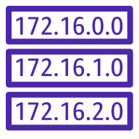





Microservices Architecture on Amazon EKS
AWS Cloud
AWS Region
Amazon VPC
EKS Cluster
Availability Zone
Availability Zone
Public subnet
Public subnet
ACM
NAT Gateway
Internet Gateway
NAT Gateway
Users
Route 53
Public RT
Public RT
Private RT
IAM
Private subnet
Private subnet
Elasticache
Control Plane
Control Plane
RDS DB
Worker Node
Worker Node
Worker Node
Worker Node
ALB Ingress
Private RT

Slide 101


Microservices
with
NodeJS, React, Typescript and Kubernetes

Slide 102
What are you going to build?
A fullstack e-commerce freelance marketplace application

Slide 103
At the end of the course
Understand the basics of microservices architecture
Build event-driven microservices using NodeJS, Express and Typescript
Use Database-per-service pattern
Setup communication styles with both Request/Response pattern and Event-driven pattern
Setup single node kubernetes cluster with Minikube and multi-node kubernetes cluster with EKS
Use Docker and Kubernetes to deploy multiple microservices either locally with Minikube or to the cloud with AWS EKS
Uzochukwu Eddie Odozi
https://kickchat.download

Slide 104
Project Architecture
CLIENT
API
GATEWAY
NOTIFICATION
SERVICE
AUTH
SERVICE
USERS
SERVICE
GIG
SERVICE
CHAT
SERVICE
ORDER
SERVICE
REVIEW
SERVICE
MYSQL
RABBITMQ
MONGODB
MONGODB
MONGODB
POSTGRESQL
RABBITMQ
RABBITMQ
MONGODB
REDIS
RABBITMQ
RABBITMQ
RABBITMQ
RABBITMQ
ELASTICSEARCH/KIBANA
Uzochukwu Eddie Odozi
https://kickchat.download

Slide 105
Hope you take this course.

